Slide 1
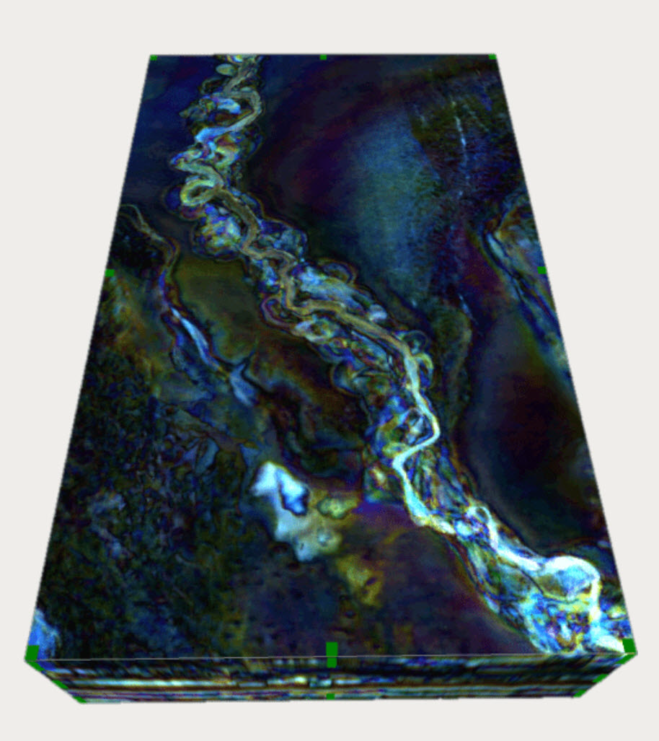

Slide 3
Well 1
Well 2
Well 4
Well 3

Slide 4
Well 1
Well 2
Well 4
Well 3

Slide 5
Potential Well 1
Potential Well 4
Potential Well 2
Potential Well 3

